Slide 1

Alzheimer’s Disease
Pathological Phases and Biomarkers
ARTIST: Denise Cole

Slide 2
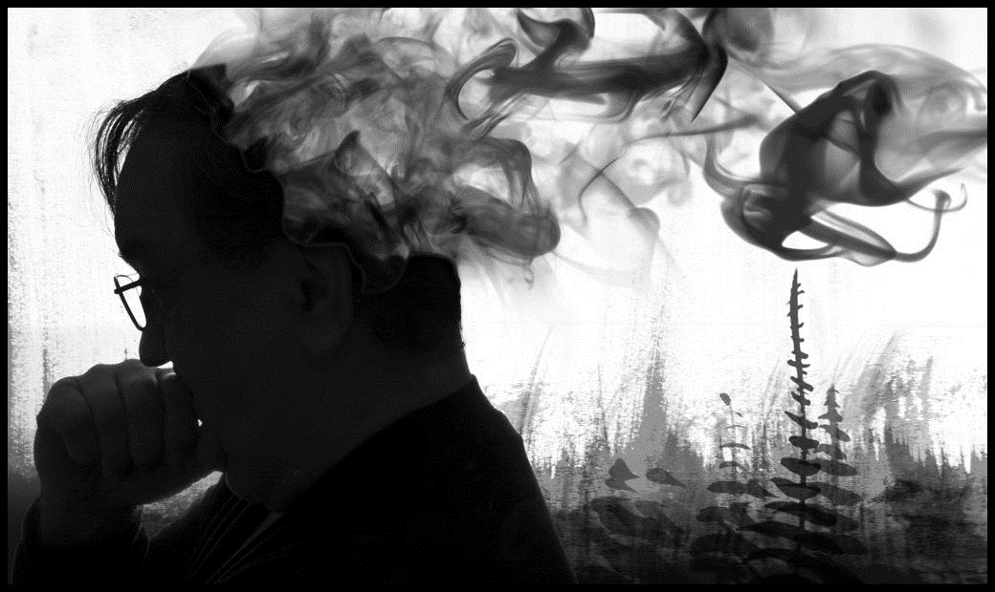
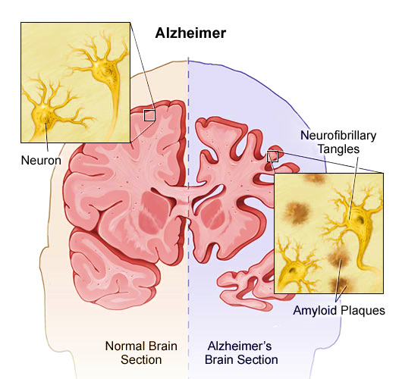
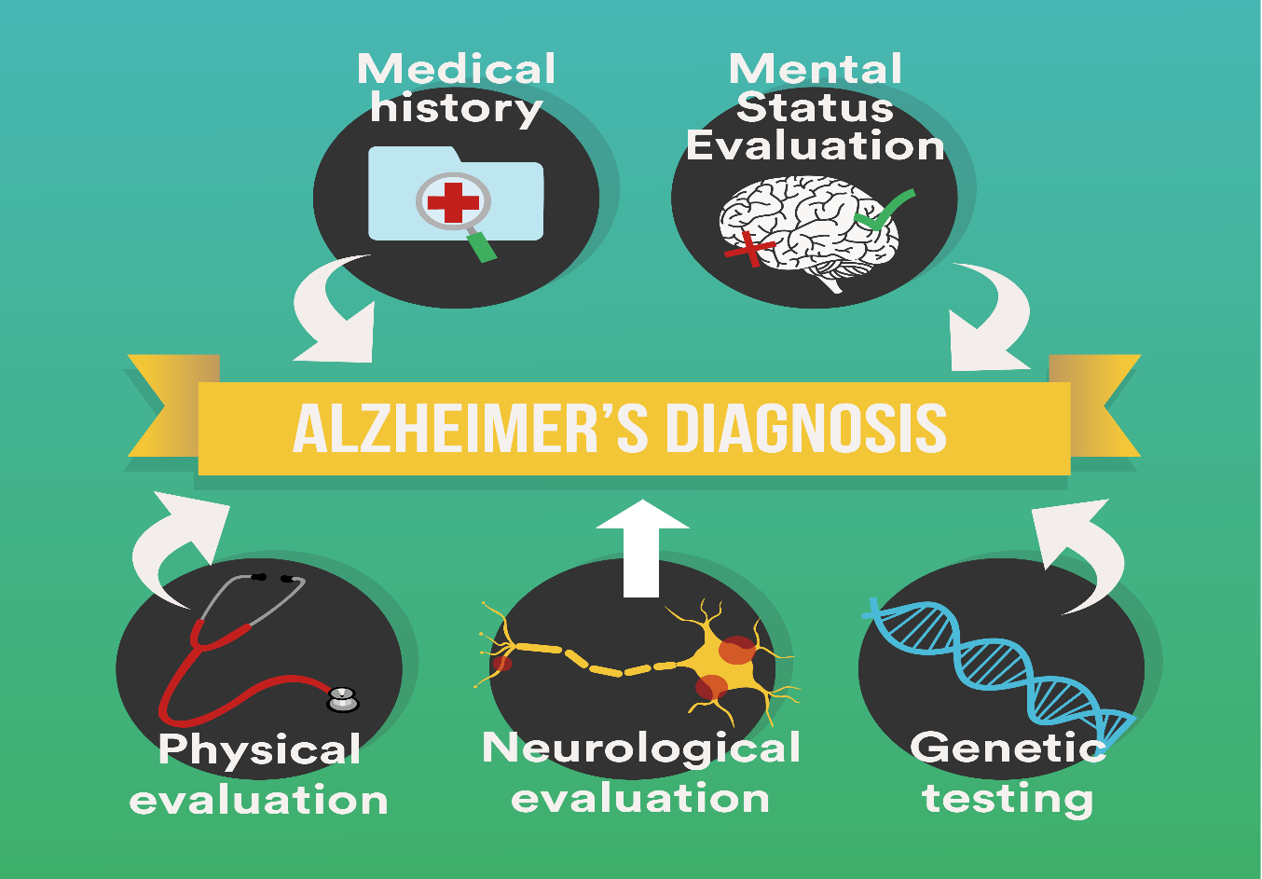
Normal
MCI
AD
PTAU
ARTIST: Jkemp
Hippocampus
ABETA
https://wilkesadultdaycare.org/blog/item/5-what-is-alzheimers

Slide 3




Objectives
Future Risk
Predict Phases
DELTON R SMITH
BRENNAN SMITH
Biomarkers
Chief Excutive Officer
Creative Director
FROM: iStock

Slide 4


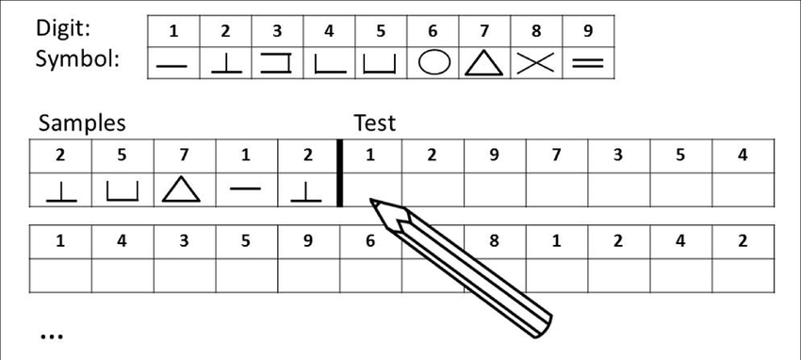
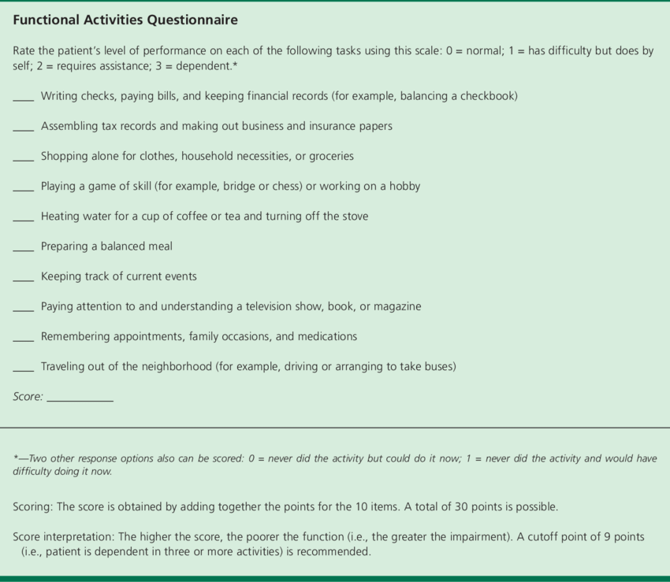





Data
Alzheimer’s Disease Neuroimaging Initiative (ADNI)
Demographical Data:
Age, Gender, Education
FAQ: Informants
Pay bills, Complete forms,
Shopping, Games, Beverage,
Meal, Current events, Pay attentions,
Appointments, Travel
Hear Words
Pause
Recall
RAVLT Verbal test
Biomarkers: PTAU, ABETA, Hippocampal Vol.
Cognitive Tests: Symbol, Verbal, Questionnaire
ARTIST: imreazisten

Slide 5
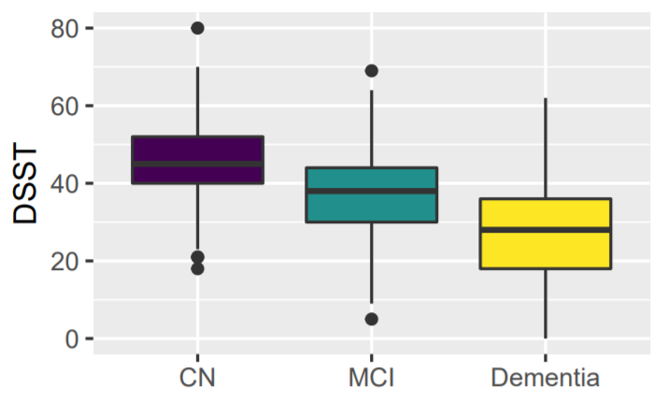
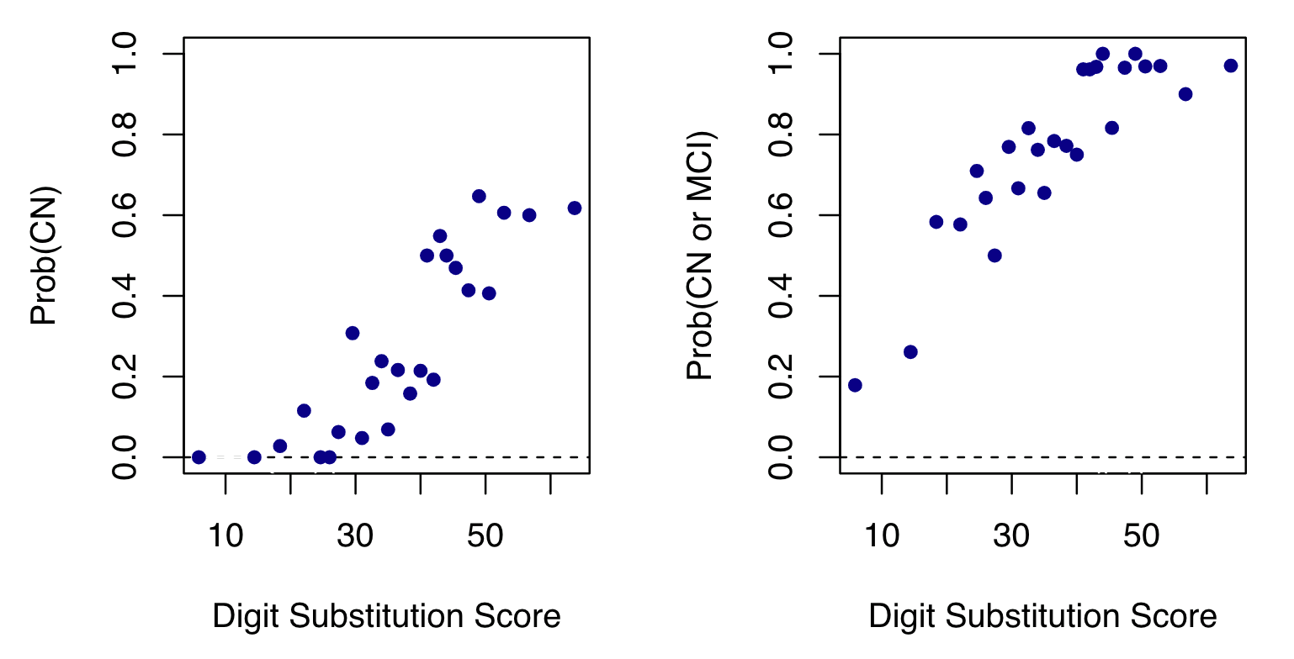
EDA
Proportional Odds

Slide 6

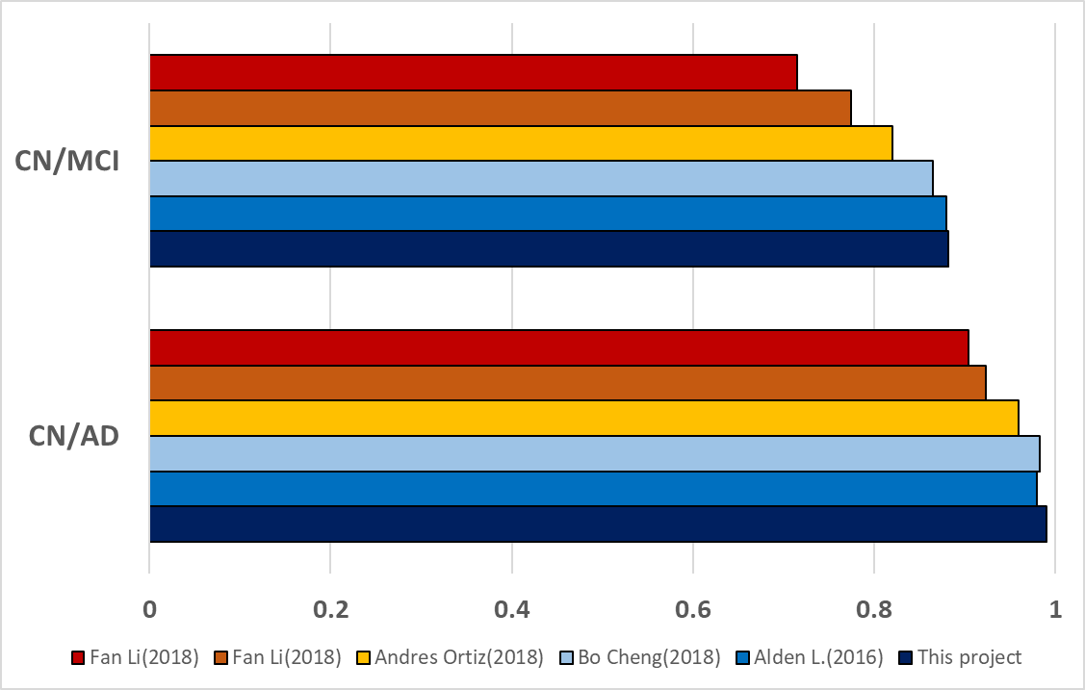


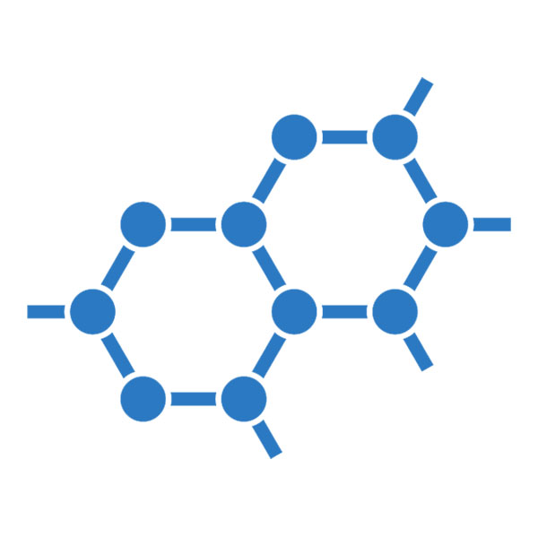

Part I: AUC of the Models
Sources | Input | Technique
Fan Li |  | ResNet
Fan Li |  | DenseNet
Andres Ortiz |  | Ensemble of SVM
Bo Cheng |  | SVM
Alden L. |  | Logistic reg.
Ours |  | Proportional odds
Cognitive Tests
Biomarkers
MRI
PET

Slide 7
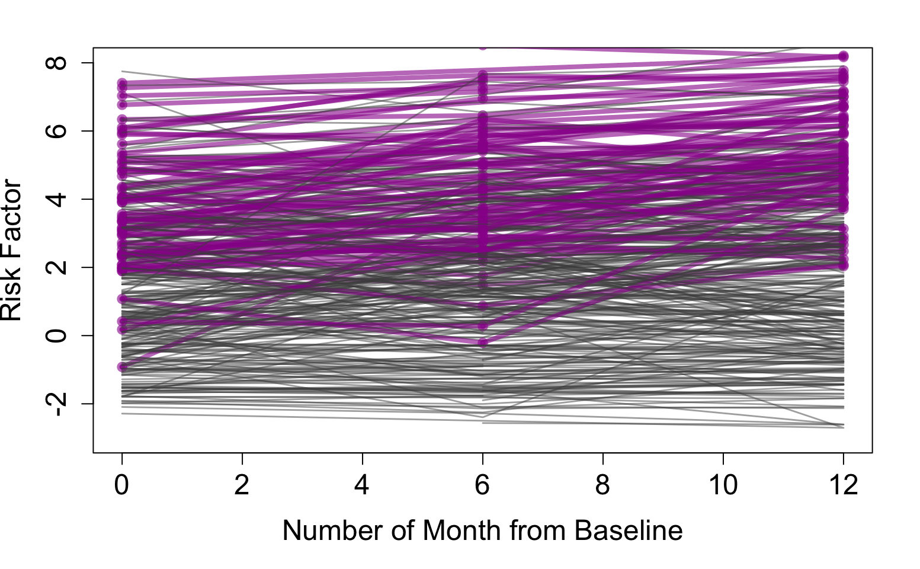
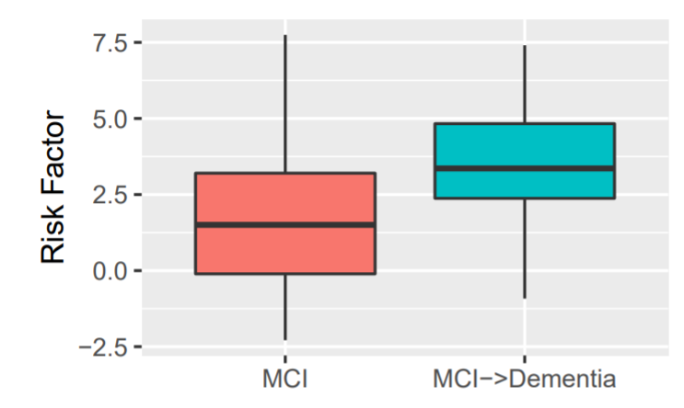
Part II: Future Risk
Turn to AD
Risk Factor
Stay as MCI
MCI
MCI->Dementia
#Months from Baseline

Slide 8
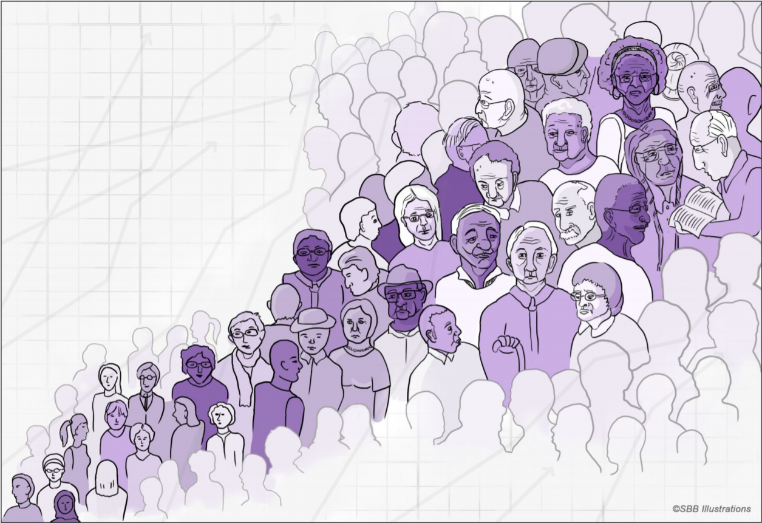
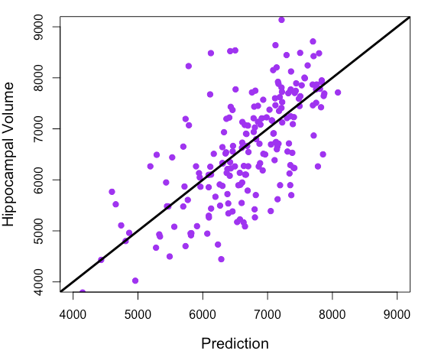
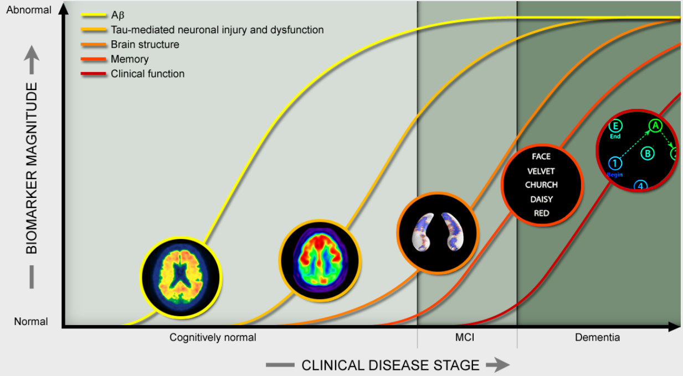
Part III: Biomarkers Model
Cannot capture PTAU and ABETA
Moderate result for Hippocampal Volume
Way Forward:
More body measurements
Baseline Information
R² 0.47
ARTIST: SSB Illustrations

Slide 9


Conclusion
Create Classification model for phases of Alzheimer’s
Significant difference in Risk Score in MCI who convert
Regression model for Hippocampal Volume
ARTIST: Chayut Wongkamthong

Slide 10
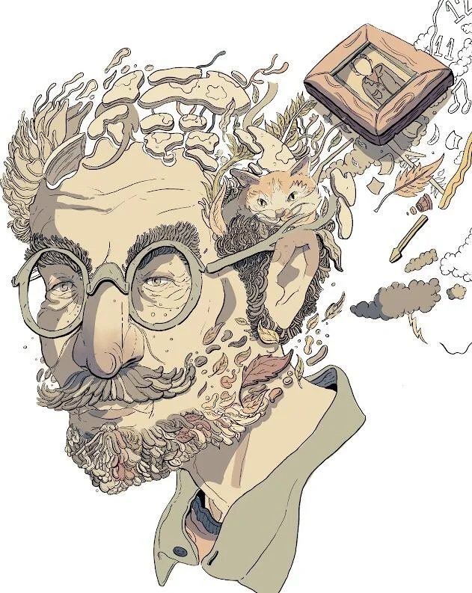
THANKS FOR
YOUR ATTENTION
ARTIST: @willdrawsthings

Slide 11

Q&A

